Slide 1

CMR COLLEGE OF ENGINEERING & TECHNOLOGY
Kandlakoya, Medchal, Hyderabad - 501401
Department of Computer Science and Engineering
Heart Disease Prediction
A.Ashwik Rao(20H51A0503)
B.Sathwik(20H51A0559)
Y.Laxminarayana(20H51A0581)
Under esteemed guidance of
MS.T. ADARANA
Assistance Professor

Slide 2
Outline
Abstract
Introduction
Literature survey
Existed system
- Problems in existed system
Research Objective of Presentation
Problem Definition
Research work
- Proposed system architecture
- Methods
- Comparison of Proposed system with an existed system
Performance Measure
Results
Conclusion
Future Work
Notes:
2

Slide 3
Abstract
Notes:
3

Slide 4
ABSTRACT
The heart is the most essential or important part of our body. The heart is used to maintain and conjugate blood in our body. There are many cases around the world related to heart disease. People lead to death from heart disease. Various symptoms like excessive breathing, fast heart rate, cholesterol, blood pressure, sudden rise in temperature, and also due to depression induced on heart by exercise etc. are some of the symptoms mentioned in the dataset. The medical profession has found a huge amount of data. This paper introduces the idea of ​​predicting heart disease by machine learning algorithms. Here we will use different machine learning algorithms like support vector classifier, random forest, naive array, decision tree and logistic regression. The algorithms used are based on characteristics and to predict heart disease. This article uses different machine learning algorithms to compare the accuracy between them. This machine learning model accurately predicts the heart attack based on the stated symptoms so that the user can easily find out the heart condition.

Slide 5
INTRODUCTION
Notes:
5

Slide 6
Introduction
Today, heart failure diseases affect more people worldwide than other autoimmune conditions. Cardiovascular Diseases (CVDs) affect the heart and obstruct blood flow through the blood vessels. Chronic ailments in CVD include heart disease (heart attack), cerebrovascular diseases (strokes), congestive heart failure, and many more pathologies.
Several risk factors for manual heart disease prediction may include inactivity in a physical form, unhealthy eating habits, or even the consumption of alcohol. Preexisting conditions, age, chest pain level, blood test results, and several such factors can be ensembled together computationally for heart disease prediction. With such well-defined parameters and the rise of data science, a data-driven approach can surely help in heart disease prediction using machine learning technologies. Early identification of heart disease of improved diagnosis and high-risk individuals using a prediction model can be recommended for a fatality rate reduction, and decision-making is improved for further treatment and prevention.
Notes:
6

Slide 7
Literature Survey
Notes:
7

Slide 8
Existed system
Rairikar et. al. used three main data mining techniques in their work: namely Decision Tree, logistic Regression are used. The main task of data Prediction is done using these three techniques
Notes:
8

Slide 9
Research Objective
Notes:
9

Slide 10
Research objective
The goal of our heart disease prediction project is to determine if a patient should be diagnosed with heart disease or not through the various attributes( Age, Sex, Chest pain, Blood Pressure levels etc) as inputs .

Slide 11
Problem Definition
Notes:
11

Slide 12
Problem Definition
A heart disease prediction algorithm can help detect heart diseases early, and maintain a healthy lifestyle. A group of researchers has developed an algorithm to predict the risk of heart disease based on many factors – age, gender, cholesterol levels, blood pressure etc. Much like any other disease, heart disease can come in many different forms.

Slide 13
Research Work
Notes:
13

Slide 14
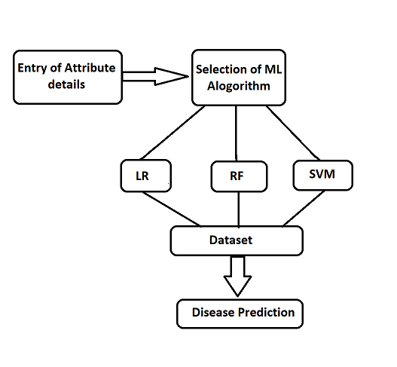
Proposed system architecture

Slide 15
Proposed Methods
1. Data Collection and Preprocessing
The proposed work predicts heart disease by exploring the above mentioned four classification algorithms and does performance analysis. The objective of this study is to effectively predict if the patient suffers from heart disease. The health professional enters the input values from the patient's health report. The data is fed into model which predicts the probability of having heart disease.
2.Machine Learning Algorithm
1.Logistic Regression
Logistic Regression is a classification algorithm mostly used for binary classification problems. In logistic regression instead of fitting a straight line or hyper plane, the logistic regression algorithm uses the logistic function to squeeze the output of a linear equation between 0 and 1. There are 13 independent variables which makes logistic regression good for classification.

Slide 16
2.Random Forest
Random Forest is a popular machine learning algorithm that belongs to the supervised learning technique. It can be used for both Classification and Regression problems in ML. It is based on the concept of ensemble learning, which is a process of combining multiple classifiers to solve a complex problem and to improve the performance of the model.
3.Support Vector Machine (SVM)
Support Vector Machine or SVM is one of the most popular Supervised Learning algorithms, which is used for Classification as well as Regression problems. However, primarily, it is used for Classification problems in Machine Learning.
The goal of the SVM algorithm is to create the best line or decision boundary that can segregate n-dimensional space into classes so that we can easily put the new data point in the correct category in the future. This best decision boundary is called a hyperplane.

Slide 17
Comparison of Proposed system with an existed system
Existed System :
It contains only 12 attributes.
ML algorithms used are Logistic Regression and Decision tree.
Accuracy is 70 %.
Proposed System :
It contains 14 attributes.
ML algorithms are Logic Regression , Random Forest and SVM.
Accuracy is 86 %.

Slide 18
Performance Measure:
Our Project predicts whether the patient gets heart disease or not.
Our Project contains 3 different Machine Learning Alogorithms to predict the heart disease.

Slide 19
Result Analysis
Finally, our proposed system provides a prediction for heart disease in percentage of a patient by using 3 Machine Learning Algorithms.They are Logistic Regression , Random Forest , SVM.

Slide 20
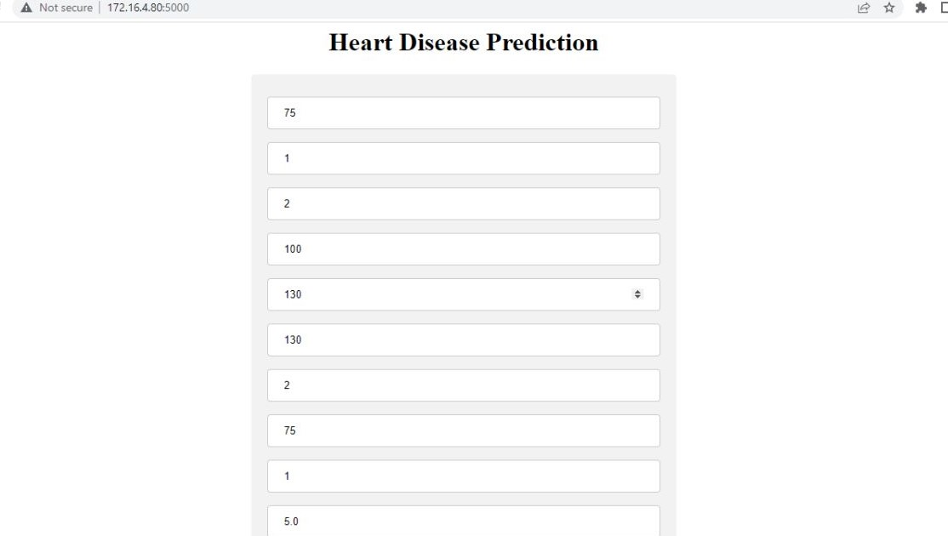

Slide 21
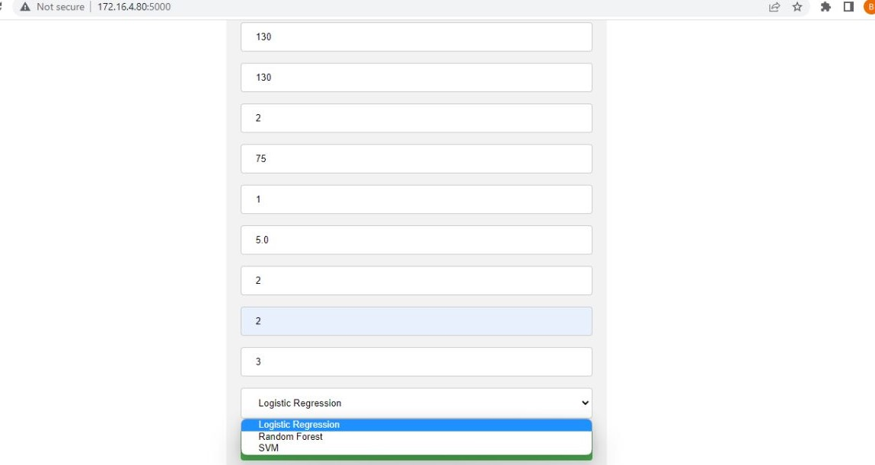

Slide 22


Slide 23
Conclusion
With the increasing number of deaths due to heart diseases, it has become mandatory to develop a system to predict heart diseases effectively and accurately. The motivation for the study was to find the most efficient ML algorithm for detection of heart diseases. This study compares the accuracy score of Logistic Regression, Random Forest and SVM for predicting heart disease using UCI machine learning repository dataset. The result of this study indicates that the Random Forest algorithm is the most efficient algorithm with accuracy score of 90.16% for prediction of heart disease. In future the work can be enhanced by developing a web application based on the Random Forest algorithm as well as using a larger dataset as compared to the one used in this analysis which will help to provide better results and help health professionals in predicting the heart disease effectively and efficiently.

Slide 24
Future work
In the future, more work can be done by using more data related to heart disease and by using different data reduction techniques. For better results and predictions of heart disease, high quality oriented datasets can be used which are free from inconsistencies.

Slide 25
References
Avinash Golande, Pavan Kumar T, Heart Disease Prediction Using Effective Machine Learning Techniques, International Journal of Recent Technology and Engineering, Vol 8, pp.944-950,2019.
T.Nagamani, S.Logeswari, B.Gomathy, Heart Disease Prediction using Data Mining with Mapreduce Algorithm, International Journal of Innovative Technology and Exploring Engineering (IJITEE) ISSN: 2278-3075, Volume-8 Issue-3, January 2019.
Fahd Saleh Alotaibi, Implementation of Machine Learning Model to Predict Heart Failure Disease, (IJACSA) International Journal of Advanced Computer Science and Applications, Vol. 10, No. 6, 2019.
Anjan Nikhil Repaka, Sai Deepak Ravikanti, Ramya G Franklin, Design And Implementation Heart Disease Prediction Using Naives Bayesian, International Conference on Trends in Electronics and Information(ICOEI 2019).
Theresa Princy R,J. Thomas,Human heart Disease Prediction System using Data Mining Techniques, International Conference on Circuit Power and Computing Technologies,Bangalore,2016.

Slide 26
Nagaraj M Lutimath,Chethan C,Basavaraj S Pol.,Prediction Of Heart Disease using Machine Learning, International journal Of Recent Technology and Engineering,8,(2S10), pp 474-477, 2019.
UCI, Heart Disease Data Set.[Online]. Available (Accessed on May 1 2020): https://www.kaggle.com/ronitf/heart-disease-uci.
Sayali Ambekar, Rashmi Phalnikar,Disease Risk Prediction by Using Convolutional Neural Network,2018 Fourth International Conference on Computing Communication Control and Automation.
C. B. Rjeily, G. Badr, E. Hassani, A. H., and E. Andres, Medical Data Mining for Heart Diseases and the Future of Sequential Mining in Medical Field, in Machine Learning Paradigms, 2019, pp. 7199.
D.Jafar Alzubi, Anand Nayyar, Akshi Kumar. "Machine Learning from Theory to Algorithms: An Overview", Journal of Physics: Conference Series, 2018
Fajr Ibrahem Alarsan., and Mamoon Younes Analysis and classification of heart diseases using heartbeat features and machine learning algorithms,Journal Of Big Data,2019;6:81.

Slide 27
Thank You!

